Slide 1

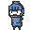
Game: Cross Dungeon
Emoji Team

Slide 2
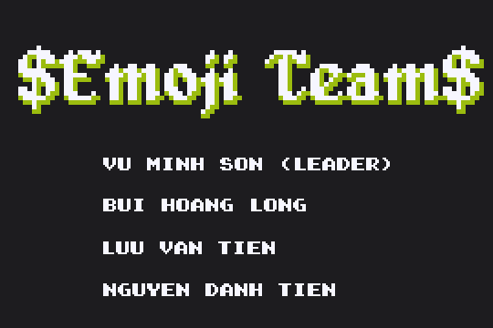
Outlines
Members
Idea
Tools
Game States
Game Play
Demo
Difficulties
Future Plan

Slide 3
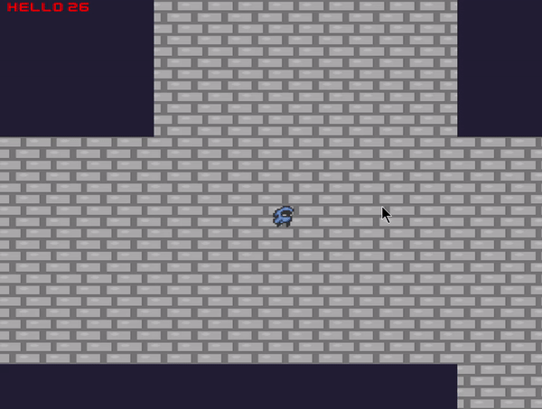
Members: Long Bùi (Long Slayer)
- Resource, Graphic, State Manager
- Map Generation
- Shop
- UI

Slide 4
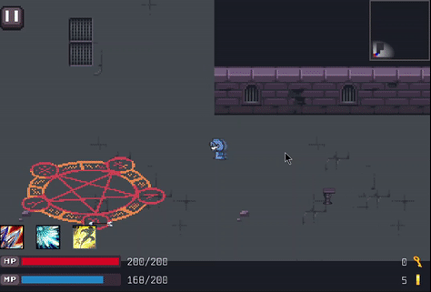
Members: Tiền Lưu (Tiền Kaka)
- Physic
- Skills
- Effects
- UI

Slide 5
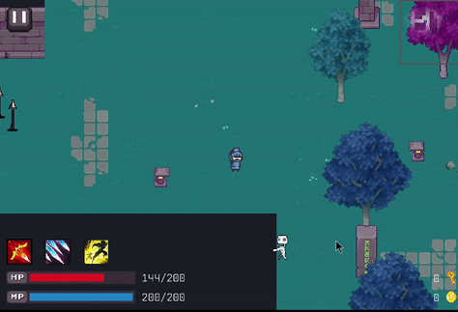
Members: Tiến Nguyễn (Tian Nguyễn)
- SFX
- Text
- Traps (*)
- Animations

Slide 6
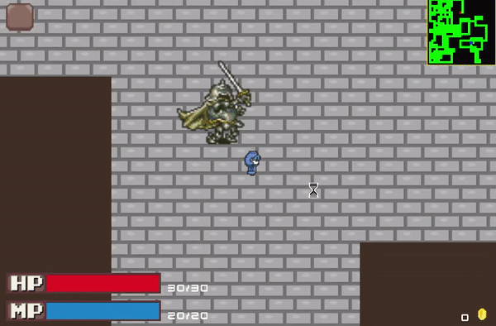
Member: Sơn Vũ (Leader)
- StateManager, Input
- Character
- Map Design
- Fixing bugs
- Assigning tasks

Slide 7
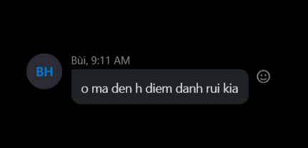
Members:
- Rotate tasks.
- Everyone can gives new ideas to project.
- Call everyone for attendance check :))

Slide 8
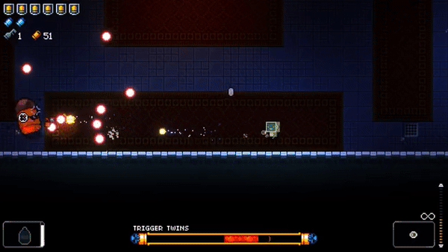
2. Idea
Based on 5 criterias:
8-bit graphic
Top down
Fast paced, Action
Replayable
Difficult
=> Genre Rougelike: Gungeon, Hades, Soul Knight, Children of Morta...

Slide 9
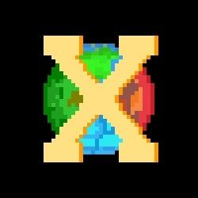
2. Idea
Name Cross Dungeon:
“Cross” over: multiple themes, levels
Dungeon:
Enemies
Traps
Rougelike:
Randomized maps
Only have one life
Buy upgrades/ skills

Slide 10
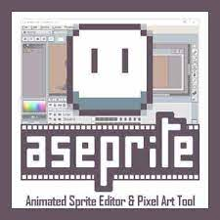
3. Tools
- Framework: 100% based on Training framework + PhysicEngine
- Call: Skype + Messenger
- Asset: itch.io/game-assets, other games (NSO, Shovel Knight,...)
- Editor: Aseprite, Tiled
- SFX/BGM: mixkit.co/Shovel Knight
- Code: google/stackoverflow

Slide 11
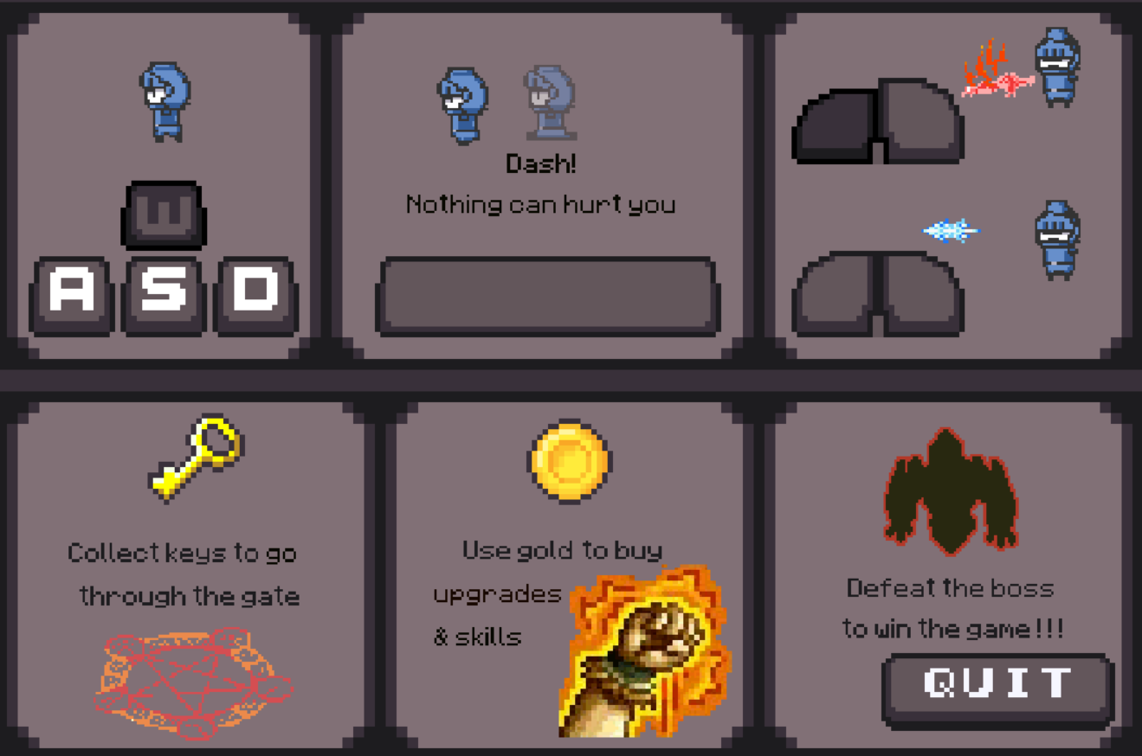
4. GameState
9 state:
- UI:
State Logo, Welcome, Instruction, Credit, Intro, Result
State Load
- GamePlay:
State Play
State Shop

Slide 12
4. GameState
Instruction
Intro
Logo
Welcome
Load
Play
Credit
Result
Shop

Slide 13
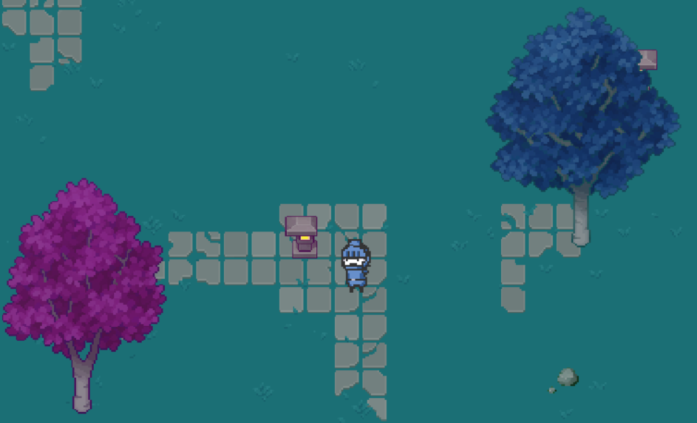
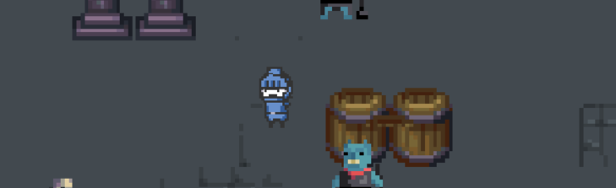
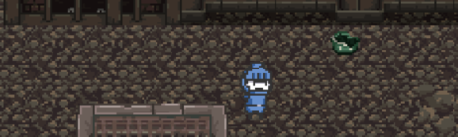
5. GamePlay
- Has 3 floors, 1 boss floor. Each floor has:
Missions: find key to go to next floor
Enemies
Traps
Drops
Decorations

Slide 14
5. GamePlay - Player
Attack:
Melee
Ranged
Dash:
Move Fast
Invincible
Skill:
DMG, cooldown
MP cost
Effects
MP regeneration: 2% every 5s

Slide 15

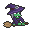
5. GamePlay: Enemy - Ranged
Witch
Shoot 3 bullets
Fly after attack
Run away
Magic Plant
Shoot non-stop
Move Randomly
Keep Distance

Slide 16
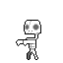
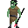
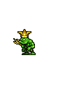
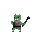
5. GamePlay: Enemy - Melee
Skeleton
Walk toward Player
Attack
Run away
Orc
Slow but high ATK
Tanky
Bear:
Faster
More annoying
Frog:
Low ATK, high HP
Drop lots of gold

Slide 17

5. GamePlay: Trap
Spikes: deal damage to all characters when shoot up
ArrowTower: shoot continuously

Slide 18
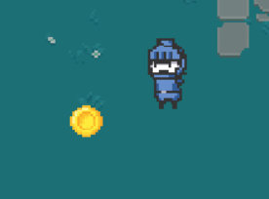

5. GamePlay: Drop
HP Potion
MP Potion
Gold
Key
Chest

Slide 19
5. GamePlay: Decoration
Different on each floor
Can take 3 bullets before destroyed
Destroyed immediately by Player melee Skill

Slide 20
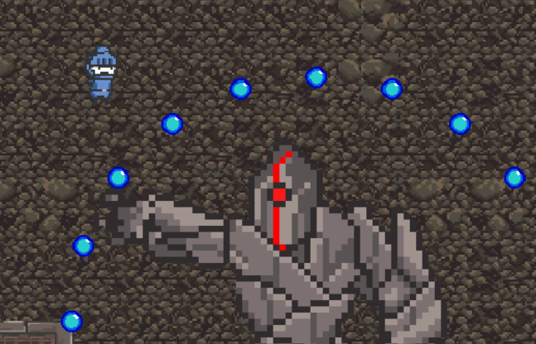
5. GamePlay: Boss
3 different type of attacks:
Charge Attack
Shoot waves of bullet
Shoot a circle of bullets
Drop a Key.

Slide 21
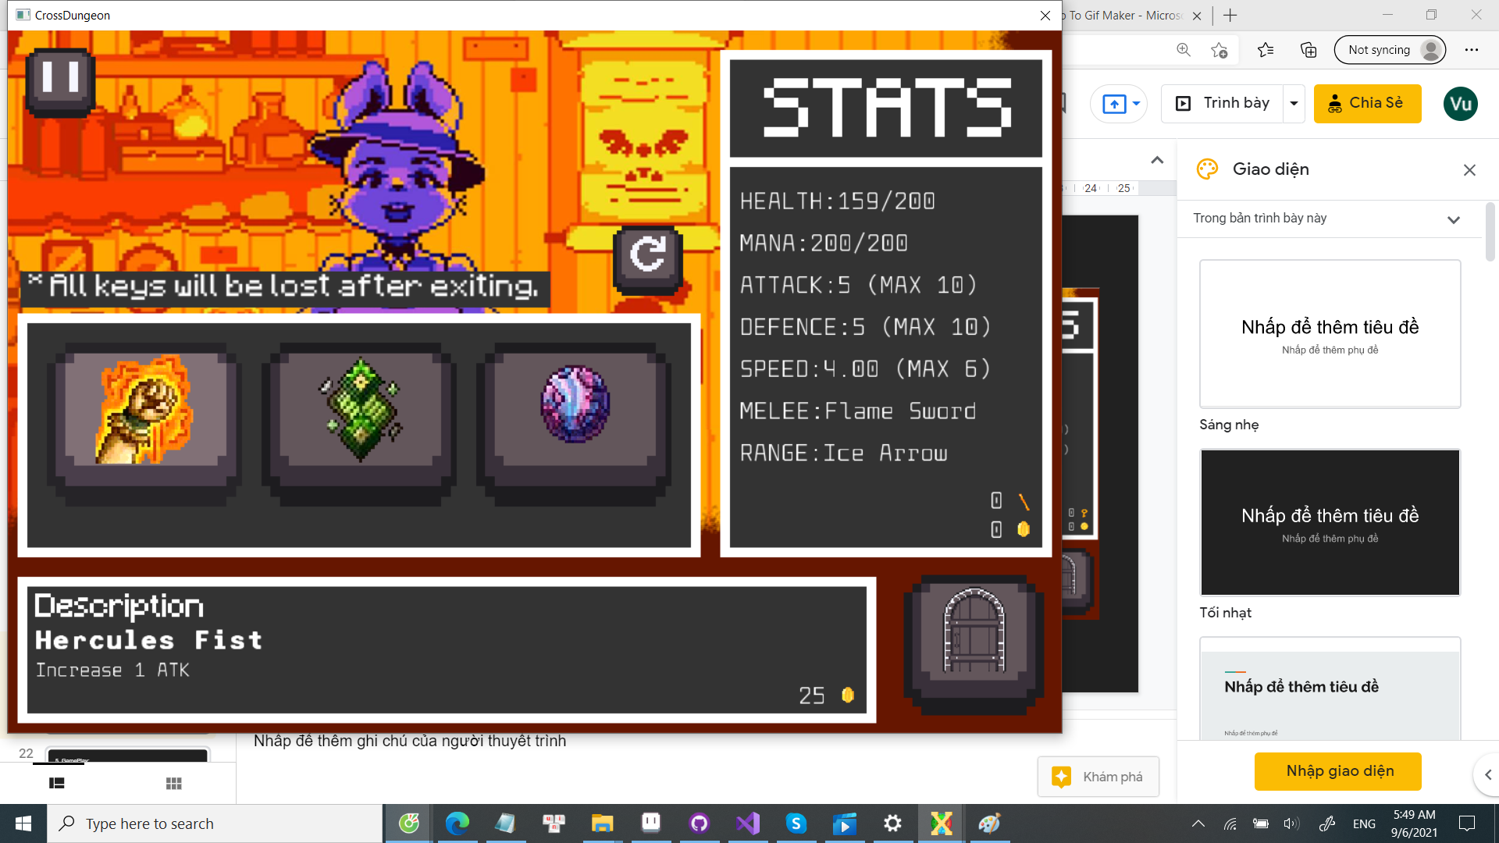
5. GamePlay: Shop
A substitute for leveling
Sell 3 items at once.
Refresh cost 1 key.
Items: 27 items
Heal: 50%, 100%
Stats Upgrade
Skills
Unique Upgrade

Slide 22
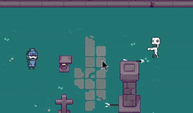
5. GamePlay: Strategy
Clearing Floor:
One Key
All key
Terminator
Killing enemies:
Only ranged/melee
Ranged> Dash>Melee
Push to trap
Hide behind arrow tower
Treasure
Shop buffs
Average playtime: 10~15 mins

Slide 23
5. GamePlay: Stats
HP
ATK
DEF
Damage Formula:
int dmg = atk*skillModifier*1000/(100+15*m_DEF);

Slide 24
6. Demo

Slide 25
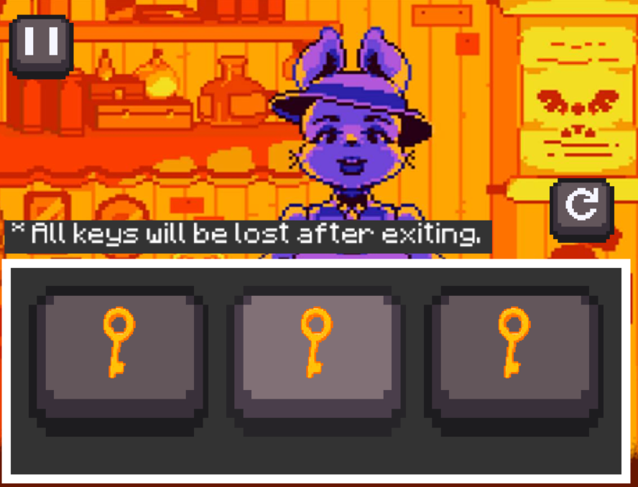
7. Difficulties
Planning Idea Late
Memory Leak
Randomize
Large Scope

Slide 26
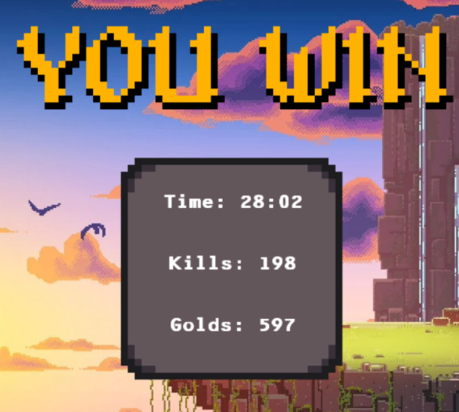
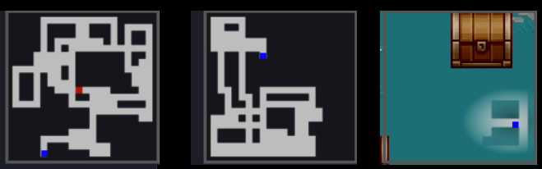
7. Difficulties:
- Long playtime: >30 min
- Difficulty too high:
Locked dash
High MP cost
Unbalance Speed
Map too big
Collision
Mini map

Slide 27
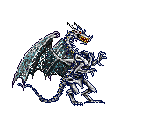
8. Future Plan
- More Characters
- More Skills
- Better Floor Generation
- More Shop Items
- More Bosses
- Adding Difficulty Selection :)))

Slide 28
END

